Slide 1
Summary of Simulating Design & Results
Kenny 10/17/2017

Slide 2
Notations:
T: time interval between time epochs
R: the bouncing range of mean valuation in time epochs
N: customer number
sig: the sigma in Gaussian function. Smaller the sigma is, closer valuations are.
Ps: the real-time price of smart token in the market
Psc: the price of smart token, broadcasted at every beginning of time slot
1

Slide 3
Bancor Market:
The whole simulating time is comprised of 1000 time slots.
In every time slot, Bancor Market processes orders launched by N customers.
Valuation Making -> Transaction Launching -> Transaction Processing
2

Slide 4
Valuation Making in Bancor:
At the beginning of every time slot, N customers will be announced about Psc, i.e., the current price of smart token.
Based on this price, customers will generate valuations of smart token in Gaussian distribution with mu and sigma.
Normal: mu = Psc, => 50% valuations larger than Psc; while 50% smaller
In Time Epoch: mu = random prick from (Psc/R, Psc*R )
3

Slide 5
Code about Random Pick:
# getrandbits(1) return False or True randomly
if bool(random.getrandbits(1)):
valuation_mu = random.uniform(Psc/R, Psc)
else:
valuation_mu = random.uniform(Psc, Psc*R)
By code, the valuation has 50% probability to be larger than Psc; while 50% probability to be smaller.
4

Slide 6
Transaction Generating in Bancor:
After customers making their valuations of smart token, they will launch transaction orders with several stipulations:
1. If valuation > Psc, customers will launch transaction orders to buy the smart token; otherwise when valuation < Psc , sell orders will be generated.
2. If no reserve tokens in hand, customer will not launch orders to buy smart token, though their valuations might be higher than Psc. Ditto for sell orders.
3. Customers make valuations and launch orders in every time slot; while in one time slot, one customer can only try to generate one order.
-- 1000 time slots, totally <=1000N transaction orders will be made
4. Customer uses all of their reserve tokens or smart tokens to buy or to sell if they have money in hand.
5

Slide 7
Code about Transaction Generation:
# self represents a customer (customer class). we name him/her as XXX
if self._valuation > self._market.getCurrentPrice() and self._reserveBalance > 0:
# XXX issues a buy order
self._market.buy(self, self._reserveBalance) # all-in policy
elif self._valuation < self._market.getCurrentPrice() and self._tokenBalance> 0:
# XXX issue a sell order
self._market.sell(self, self._tokenBalance)
else:
# nothing to do
pass
After customers generating their transaction orders by valuations and money they hold, they wait to see whether their transactions could be handled by market.
6

Slide 8
Transaction Processing in Bancor:
Bancor Market processes customers' transaction orders one by one.
In market’s eyes:
When dealing with one of customers‘ transaction orders,
if the real-time price of smart token does not meet this customer‘s valuation, the market will announce the customer to cancel this order and skip this transaction order to try to deal with the next customer’s order.
In customers’ eyes:
Customers generate valuations of product first (by Psc), and then accord to the product‘s price in market (Ps) to decide whether to cancel the transaction.
7

Slide 9
Results in Bancor:
(a) Without Reseve Aid (b) With 200 Reserve Aid
Y-axis: Price of smart token (ETH)
X-axis: time of the simulation
8

Slide 10
Explanation of the Stable Price:
# The Initialization code for example
KennyCoin = Smartcoin(name=‘Kenny’,reservetokenName=‘ETH’,initCRR=0.5,
initPrice=1,initIssueNum=800000)
# Bancor Market Initialization
MyBancorMarket = BancorMarket(smartToken = KennyCoin)
# Customer Initialization
custList = []
custNum = 2000
for i in range(custNum):
Joe = Customer(smartToken = KennyCoin, market = MyBancorMarket,
tokenBalance = 200,
reserveBalance = 200)
custList.append(Joe)
9

Slide 11
Explanation of the Stable Price:
Market:
Price of Kenny Coin: 1.0 ETH
Smart Token Supply: 800000
All Customers:
Reserve Balance: 400000 # 200 * 2000
Smart Token Balance: 400000
Time epoch, everyone wants to buy
Market:
Price of Kenny Coin: 1.414 ETH
Smart Token Supply: 1131371
All Customers:
Reserve Balance: 0
Smart Token Balance: 731371
Normal case,
mu = 1.414 ETH
Market:
Price of Kenny Coin: 0.957 ETH
Smart Token Supply: 765686
All Customers:
Reserve Balance: ≈433578
Smart Token Balance: ≈365685 # 731371/2
Normal case,
mu = 0.957 ETH
now is back close to 1.0 ETH
Market:
Price of Kenny Coin: ≈0.979 ETH
Smart Token Supply: 783148
All Customers:
Reserve Balance: ≈ 383146
Smart Token Balance: ≈ 416674
10

Slide 12
Explanation of the Stable Price:
Therefore, the reason why in our simulator, the Price of smart token can always go back to average after its bouncing, is that under all-in policy, almost half of customers cannot launch transaction orders after time epoch.
Potential Solution:
We can add customers‘ reserve or smart token balance if they are run out.
e.g. add 200 reserve tokens to customers once they run out reserve
11

Slide 13
Y-axis: Price of smart token (ETH)
X-axis: time of the simulation
Price from 1.0 ETH rises to about 10 ETH.
However, how much money should we add becomes a tricky problem.
Also, we cannot add too many smart tokens to customers as smart tokens cannot be unlimitedly added. (the total sum should <= Smart Token Supply).
12

Slide 14
Explanation of the Stable Price:
In my opinion, the Bancor Market does have its ability to stabilize the price of smart token.
(even in solution, the price of smart token gradually recovers to its original status before the time epoch)
The reason why the price of smart token is stable is that our all-in policy exaggerates the recovering ability of Bancor.
13

Slide 15
Cancel Rate in Bancor Market:
Further, since transaction orders might be canceled in market, we also track the cancel rate of transaction orders successfully launched by customers, which is plotted in Figure 2.
14

Slide 16
Figure 2. Figure about cancel rate in Bancor Market. Here the cancel rate is calculated by (# of all canceled orders / # of all launched orders). The x-axis: T-R-N-sig.
T: interval between time epochs, R: bouncing range,
N: customers’ number, sig: sigma in Gaussian
15

Slide 17
Cancel Rate in Bancor Market:
In Figure 2, what we can learn is that with smaller sigma, the transactions‘ cancel rate is much higher,
which indicates more tightly customers make their valuations, more likely they need to cancel their transaction orders.
Next several slides present the mathematical proof of this result with our model design.
16

Slide 18
Review of Valuation Making in Bancor:
At the beginning of every time slot, N customers will be announced about Psc, i.e., the current price of smart token.
Based on this price, customers will generate valuations of smart token in Gaussian distribution with mu and sigma.
Normal: mu = Psc,
In Time Epoch: mu = random prick from (Psc/R, Psc*R )
17

Slide 19
Proof of smaller sigma, higher cancel rate:
The Gaussian function in different sigma settings. Smaller the sigma is, steeper the Gaussian curve is.
18

Slide 20
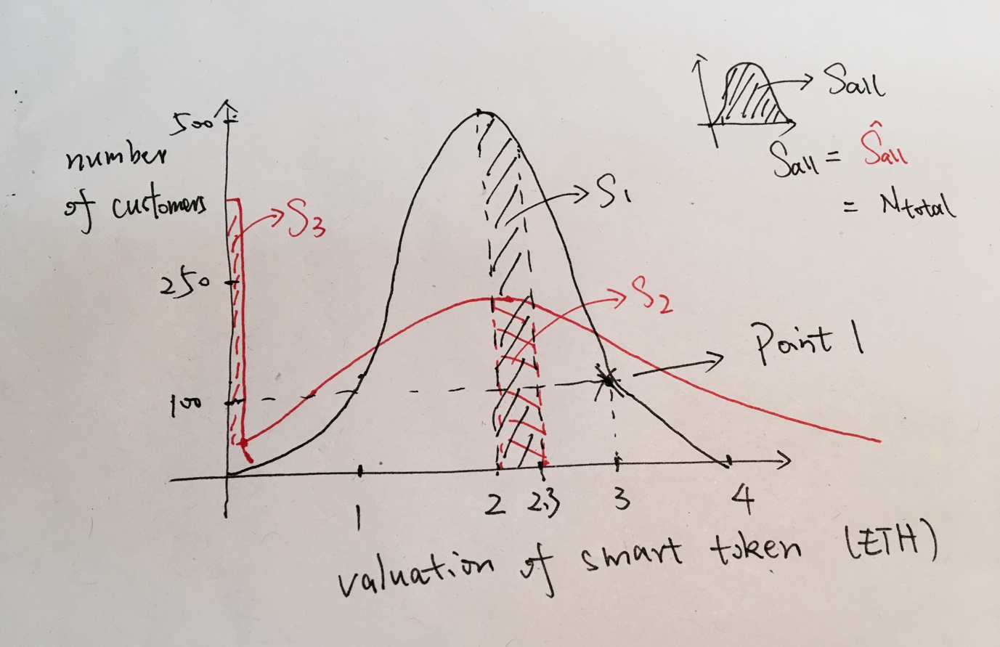
Proof of smaller sigma, higher cancel rate:
The black curve shows the valuation distribution with sig1, the red curve shows with sig2. By the previous slide, we know sig2 > sig1. The mean valuation is 2.
19

Slide 21
The point 1 means there are 100 customers making valuation as 3 ETH.
Thus, by doing a simple calculus, like small plot in the right-top corner of Figure, we know that the total area rounded up by x-axis and Gaussian curve is the total number of customers.
20

Slide 22
Since both in red curve and black curve, there are totally 2000 customers coming into market,
we know that:
S all = S all = N total
= 2000 (# of customers)
21

Slide 23
When one customer successfully making his transaction, the price of smart token in market will fluctuate, from 2 ETH to 2.3 ETH.
22

Slide 24
In this case, the blacked shadowed area S1 or the red shadowed area S2 presents the number of customers who now cannot make transactions.
(buy-order valuation smaller than current price of smart token)
23

Slide 25
Hence, the current probability of customers‘ order being canceled in black-curve distribution:
Pr = S1/S all = S1/N total.
Similarly,
Pr = S2/S all = S2/ N total.
Apparently, S1 > S2. Therefore, in current state, Pr > Pr.
24

Slide 26
Proof of smaller sigma, higher cancel rate:
In fact, whether the price of smart token is increasing or decreasing, Pr is always larger than Pr. This indicates, at every time, the probability of transaction being canceled in Black curve Gaussian distribution (with sig1) is larger than it in red curve (with sig2).
Combining with the fact that sig2 > sig1, the proof of smaller sigma causing higher cancel rate is done.
25

Slide 27
Proof of smaller sigma, higher cancel rate:
If you are careful enough, you might notice the weird S3 area.
This is because when the valuation by Gaussian function is smaller than 0, we set this valuation to be 0.001 * mean valuation (in our example is 0.002). Therefore, S3 actually equals with number of customers who generate valuation smaller than 0.
for i in range(custNum):
if custValuation_list[i] < 0:
# Customer does not want to sell their token in free.
# Here we give them a small valuation when valuation < 0
custList[i].changeValuation(0.001*currentMarketPrice)
else:
custList[i].changeValuation(custValuation_list[i])
Actually, S3 does not disturb the proof at all, since larger the S3 is, smaller the S2 is.
26

Slide 28
Classic Market:
The whole simulating time is comprised of 1000 time slots.
In every time slot, Classic Market processes the orders launched by N customers by managing the order list in the market.
Valuation Making -> Transaction Launching -> Transaction Processing
27

Slide 29
Valuation Making in Classic:
The valuation making in Classic Market is similar with Bancor Market.
However, since the real-time price of the product, i.e., Ps does not change, the mean valuation is constant in normal cases. That is that the mu always equals Ps.
Normal: mu = Ps, Ps is a constant.
In Time Epoch: mu = random prick from (Ps/R, Ps*R )
28

Slide 30
Transaction Generating in Classic:
1~4 stipulations are similar with Bancor Market.
5. A customer will not launch new order if his order has not been fulfilled.
For instance, in a certain time slot, a customer launches a sell order at valuation 5 ETH to sell all of his 200 smart tokens.
However, in the next time slot, he finds that only 120 smart tokens have been sold. Therefore, he will not launch new order and continue to wait for his remaining 80 smart tokens being sold at valuation 5 ETH.
In the end of simulation, i.e., 1000 time slots have passed, if this transaction order is still unfinished in market, we say this order should be canceled.
29

Slide 31
Transaction Processing in Classic:
Classic Market manages an order list to process all transaction orders launched by customers.
In short, all transaction orders from customers will be separated into two sub-lists, named as sell list and buy list. In each list, orders will be sorted by the valuation of these orders.
30

Slide 32
Transaction Processing in Classic:
31
Notes:
Blue plus red cancel
Red fail

Slide 33
Transaction Processing in Classic:
Both Partially Failed orders and Totally Failed orders will be remained in order list and expect in the next time slot they can be finished.
However, if these orders are never finished -- after 1000 time slot, they still are remained in the market, we then say these orders should be canceled.
Thus, we calculate the cancel rate by:
# of orders remained in market / # of all launched orders.
The Classic Market's cancel rate statistic graph is plotted in Figure 4:
32

Slide 34
Cancel Rate in Classic Market:
Figure 4: The transaction orders' cancel rate in classic market. The x-axis: T-R-N-sig.
33

Slide 35
Comparison Between Bancor and Classic's Cancel Rate :
By comparing the transactions' cancel rate between Bancor Market and Classic Market, the result is shown in Figure 5.
The review of Cancel Rate:
In Bancor:
Why: The price of smart token cannot meet customer's valuation in order.
Cal: cancel rate = # of all canceled orders / # of all launched orders
In Classic:
Why: Customer's order cannot be finished before the end of simulation.
Cal: cancel rate = # of orders unfinished / # of all launched orders.
34

Slide 36
By Figure 5, we can know the cancel rate in Bancor Market is much higher than in Classic Market
Figure 5: The comparison of cancel rate between Bancor Market and Classic Market. The x-axis: T-R-N-sig.
35

Slide 37
Summary:
Silde 8: if customers keep investing money in Bancor Market (never run out of reserve tokens), the market craze in time epoch can lead the price of smart token bouncing around and finally to extremely high.
Silde 15: the order‘s cancel rate in Bancor Market can be quite high -- reaching beyond 10% in several parameter settings, especially when customers’ valuations are made tightly, i.e., sigma is small.
Slide 34: The low classic cancel rate in Figure 4 indicates the "co-incidence of double wants" might not be a problem in Classic Market.
Slide 36: The cancel rate in Bancor Market is always much higher than in Classic Market.
36

Slide 38
Summary:
The code as well as code‘s tutorial are presented on:
https://github.com/Ohyoukillkenny/Bancor-Simulator
37

Slide 39
Flaw and Future Work:
Up to now, what we have fully discussed in Bancor market is based on limited order.
Also, our evaluating metrics might not be representative enough.
Now, I am still working on modifying our simulating model in order to make it feasible in more general cases.
38

